Slide 1
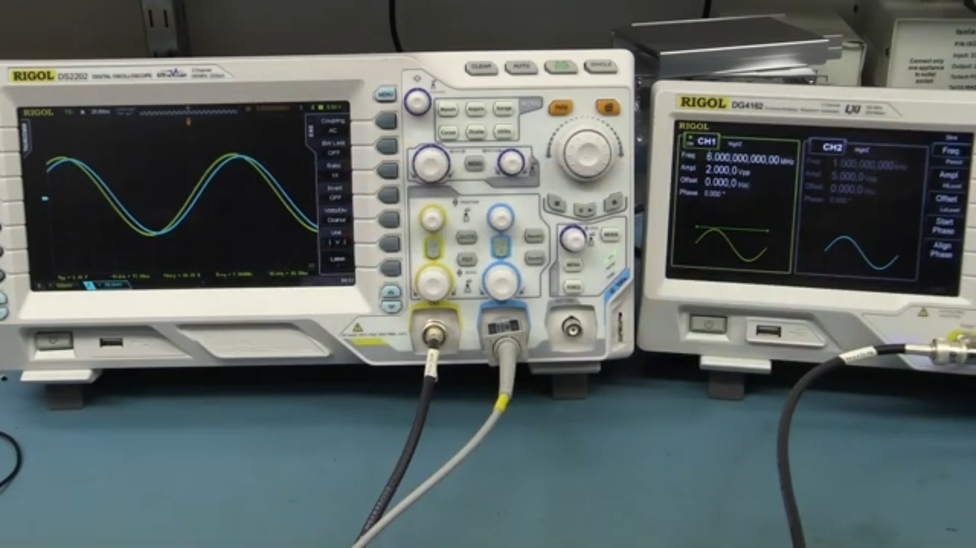
Function Genrator

Slide 2
Contents Layout :
Introduction
1
2
Component
3
Circuit Diagram
4
Waveforms

Slide 3
INTRODUCTION
In electrical engineering, a function generator is usually a piece of electronic test equipment or software used to generate different types of electrical waveforms over a wide range of frequencies. Some of the most common waveforms produced by the function generator are the sine wave, square wave, triangular wave and sawtooth shapes.

Slide 4
INTRODUCTION
These waveforms can be either repetitive or single-shot (which requires an internal or external trigger source) Another feature included on many function generators is the ability to add a DC offset. Integrated circuits used to generate waveforms may also be described as function generator ICs.

Slide 5
INTRODUCTION
Although function generators cover both audio and radio frequencies, they are usually not suitable for applications that need low distortion or stable frequency signals. When those traits are required, other signal generators would be more appropriate.

Slide 6
INTRODUCTION
Some function generators can be phase-locked to an external signal source (which may be a frequency reference) or another function generator.
Function generators are used in the development, test and repair of electronic equipment. For example, they may be used as a signal source to test amplifiers or to introduce an error signal into a control loop. Function generators are primarily used for working with analog circuits, related pulse generators are primarily used for working with digital circuits.

Slide 7
COMPONENT
1
Timer 555
2
Pot100K
3
Cap100 nano
4
Pot 124k
Cap 10 Micro
5

Slide 8
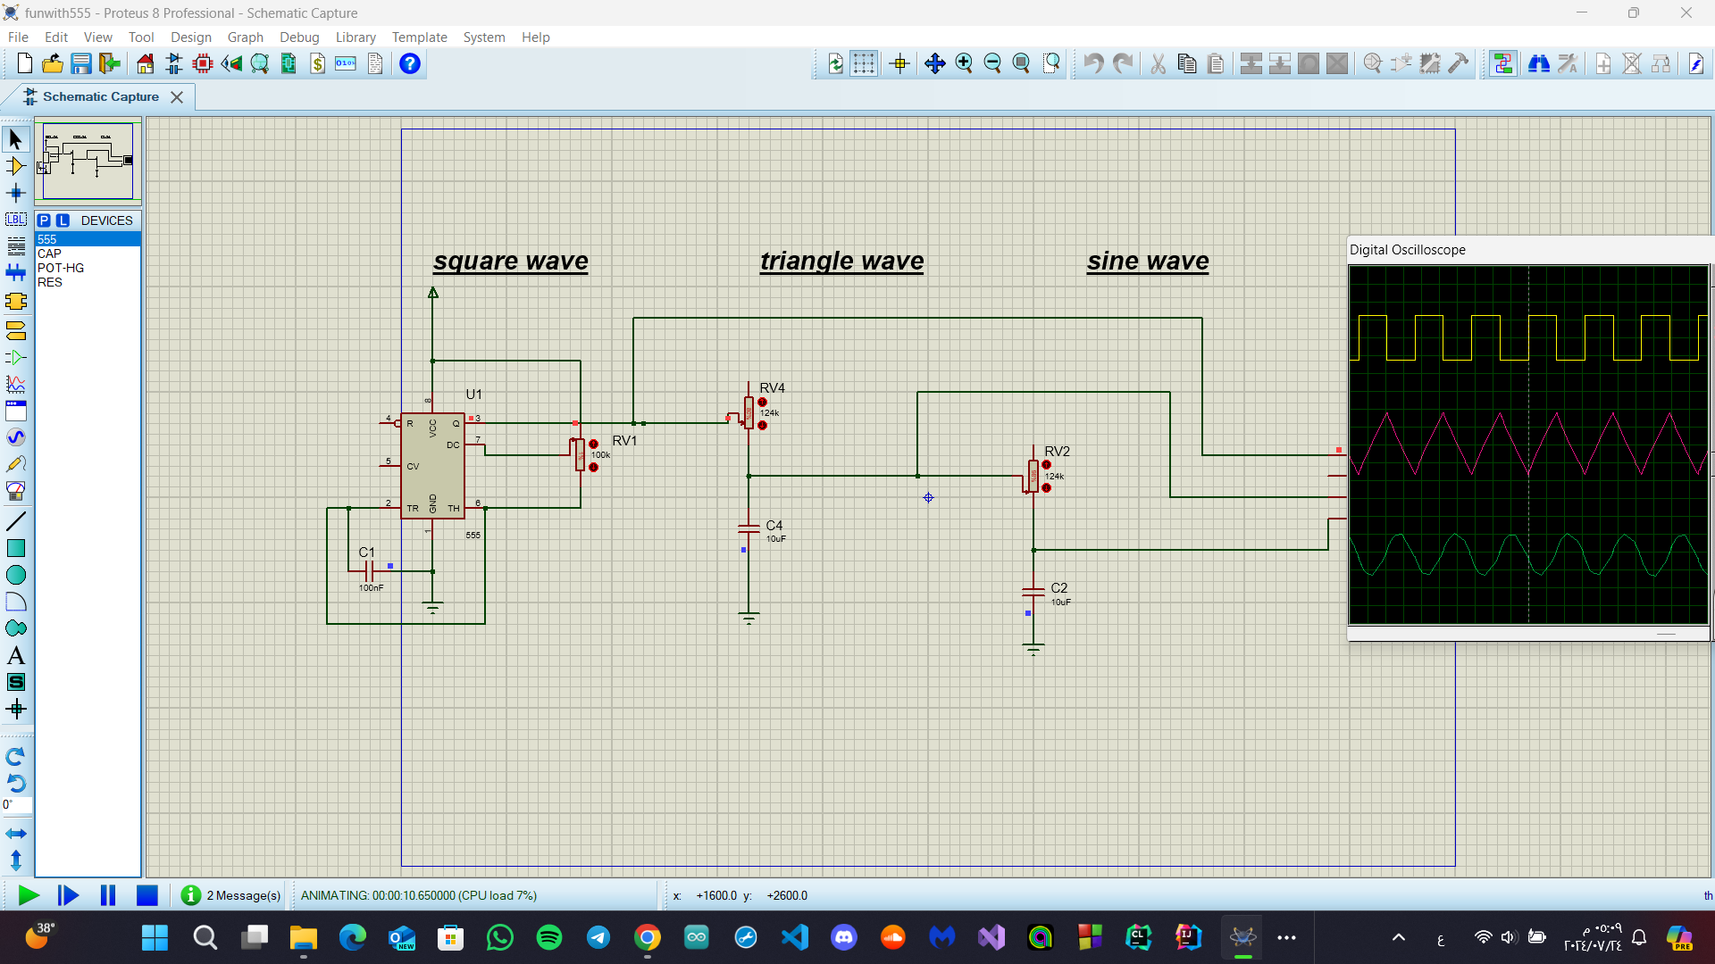
Circuit Diagram

Slide 9
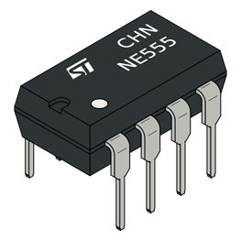
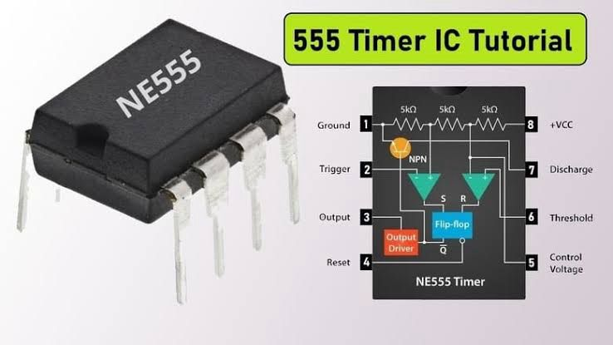
Timer 555
What Is a 555 Timer IC?
The 555 timer IC is an important tool in electronic design and operates over a wide voltage range from 4.5V to 15V DC. This multifunctional integrated circuit can create precisely timed delays and oscillations. It consists of various internal components such as transistors, resistors, diodes, and flip-flops. These components coordinate to perform the critical operations of the IC.

Slide 10

Timer 555
After power is applied, transistors within the IC manage the timing of the current flow. Resistors help control this current flow, ensuring that the circuit operates within safe parameters. Diodes protect circuits by preventing current from flowing back, which can damage the IC. Finally, the flip-flop stores information about timing and periodically releases it to create delays or oscillations.

Slide 11

Type Of Modes
1
Monostable Mode (Single Trigger Mode)
1
Bistable Mode (Bi-Directional Trigger Mode)
1
Astable Mode (Free Oscillation Mode)

Slide 12
Astable Mode
Astable mode converts the 555 timer into a continuous square wave generator, called a multivibrator. In this configuration, the frequency and duty cycle of the waveform are determined by two resistors, R1 and R2, and capacitor C. The equations for charge and discharge time are t1 = 0.693 × (R1 + R2) × C and t2 = 0.693 × R2 × C respectively, and the frequency is given by f = 1.44 / ((R1 + 2 × R2) × C). Adjusting R1, R2, and C allows precise control of the signal's characteristics for everything from blinking an LED to generating an audio signal. Designing and fine-tuning these parameters can provide practical experience in shaping the output to meet specific project requirements.

Slide 13
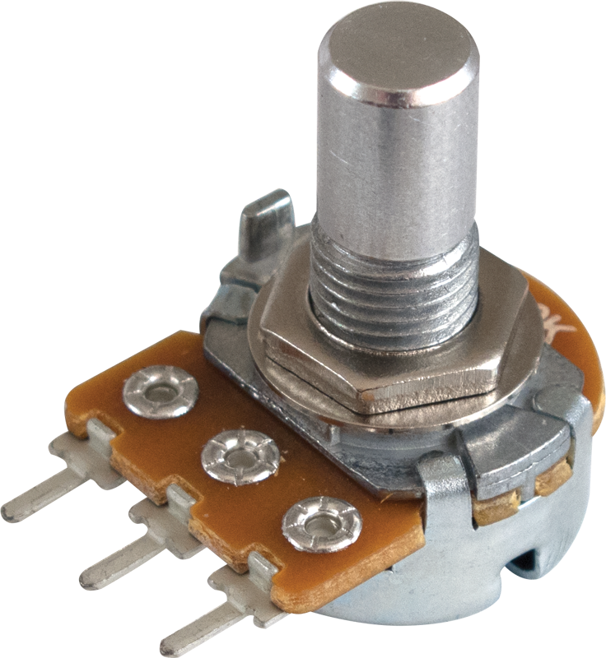
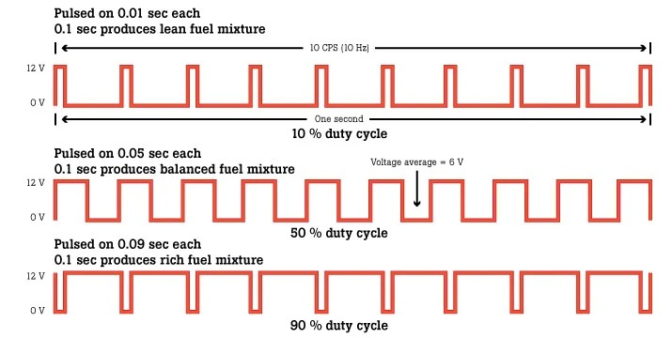
POT100K
it used to control the duty cycle
What Is The Duty Cycle?
Duty cycle is the ratio of time a load or circuit is ON compared to the time the load or circuit is OFF.Duty cycle, sometimes called "duty factor," is expressed as a percentage of ON time. A 60% duty cycle is a signal that is ON 60% of the time and OFF the other 40%.
Duty Cycle Equation
Calculating the Duty CycleDuty Cycle (%) = (Active Time / Period) * 100

Slide 14
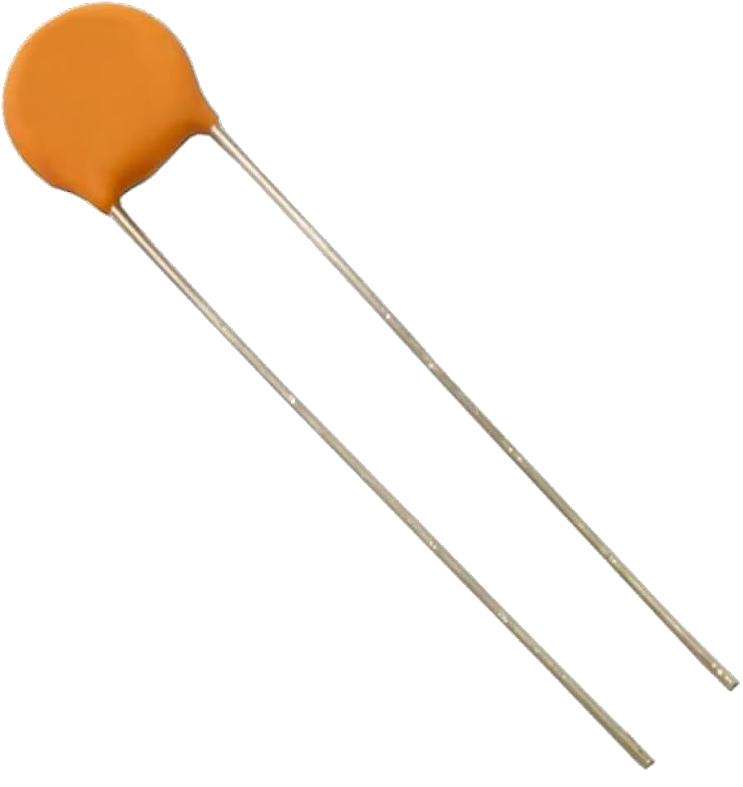
CAP100NANO
it used to increase the frequency for signals from this equation F=1.44 / ((R1 + 2 × R2) × C

Slide 15

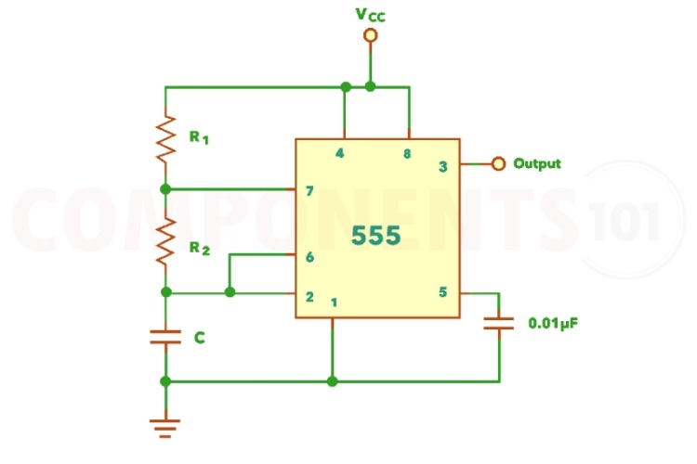
SQUARE WAVE
555 Square Wave Generator Circuit DesignHere is a simple 555 timer astable multivibrator circuit.
The IC 555 operates as an astable multivibrator with three external components: two resistors (R1 and R2) and a capacitor (C). Pins 8 and 4 are connected to the power supply, pin 1 to ground, and pin 5 to ground through a capacitor. Pins 2 and 6 are linked, allowing it to self-trigger without an external pulse, acting as a free-running oscillator. The output is at pin 3. The timing circuit consists of R1, R2, and C.On power-up, the 555 timer's flip-flop resets, outputting low and discharging the capacitor. When the voltage drops below 1/3 VCC, the output goes high, allowing the capacitor to charge. Once it exceeds 2/3 VCC, the output goes low, and the cycle repeats, generating rectangular pulses. The blue waveform shows the capacitor's charging curve, and the red one is the output waveform.

Slide 16

TRIANGLE WAVE
The circuit is a triangle waveform generator that uses as few parts as possible.A 555 timer IC, 2 resistors and two capacitors make the triangle wave.The IC is connected in a 50% duty-cycle astable square-wave oscillator circuit.The square-wave output is fed from pin 3 of the IC to an RC shaping circuit.When the 555’s square-wave output goes high, C2 begins to charge through R2 and the voltage across C2 increases as long as the output remains high. When the IC’s output goes low again, C2 begins to discharge through R2 reducing the voltage C2 as long the output remains low. The resulting waveform accross C2 takes the shape of a triangle. The best waveform linearity is obtained when R2 and C2 are made as large as possible. With the component values shown, the peak-to-peak output is 0.5 V at a frequency of about 200 Hz

Slide 17
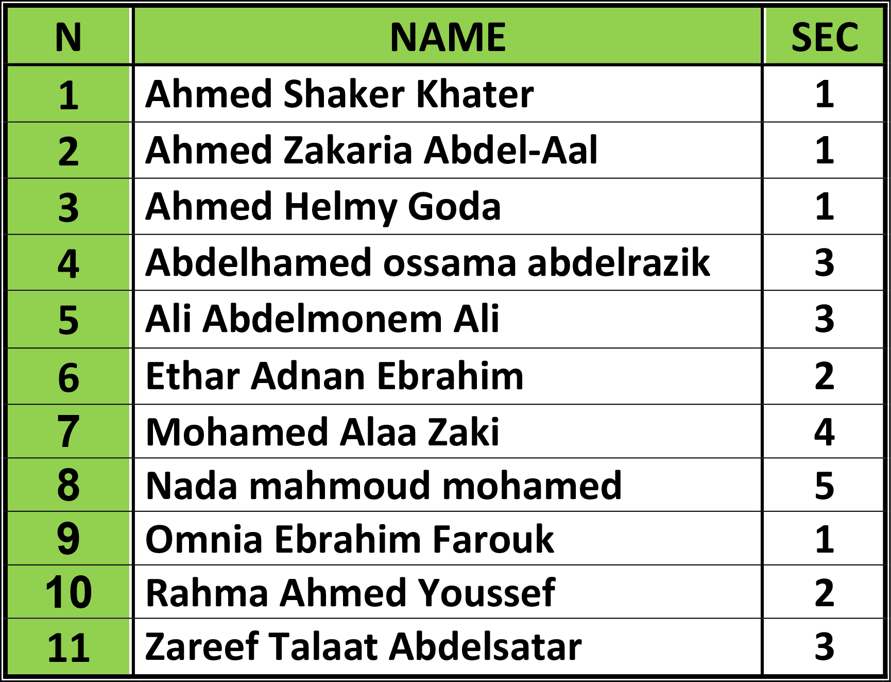
TEAM WORK

Slide 18
THANK YOU
Dr Mohamed Gabr
Eng Enas Mostafa
Eng Aya Sharif

